Slide 1
Store Sales Analysis
Analysis by Daryl Sangalang

Slide 2
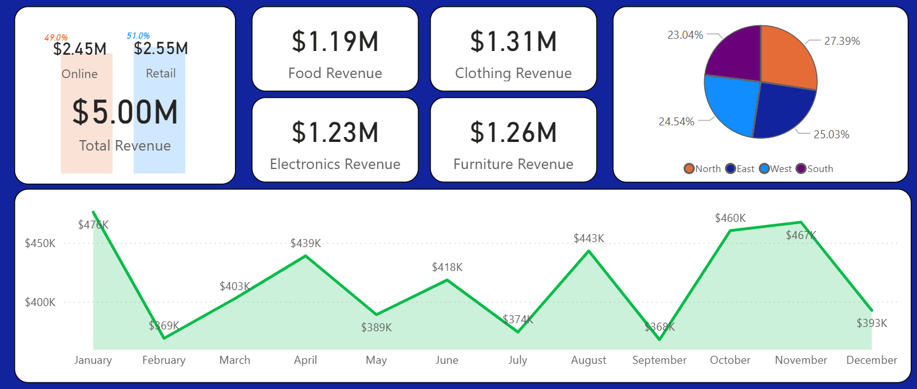
Year 2023 – Performance Overview
The Company ended the year with a total revenue of $5m for the year 2023, 51% from Retail sales channel and 49% from Online Sales channel.
Product Category breakdown of the revenue:
Clothing ($1.31m)
Furniture ($1.26m)
Electronics ($1.23m)
Food ($1.19m)

Slide 3
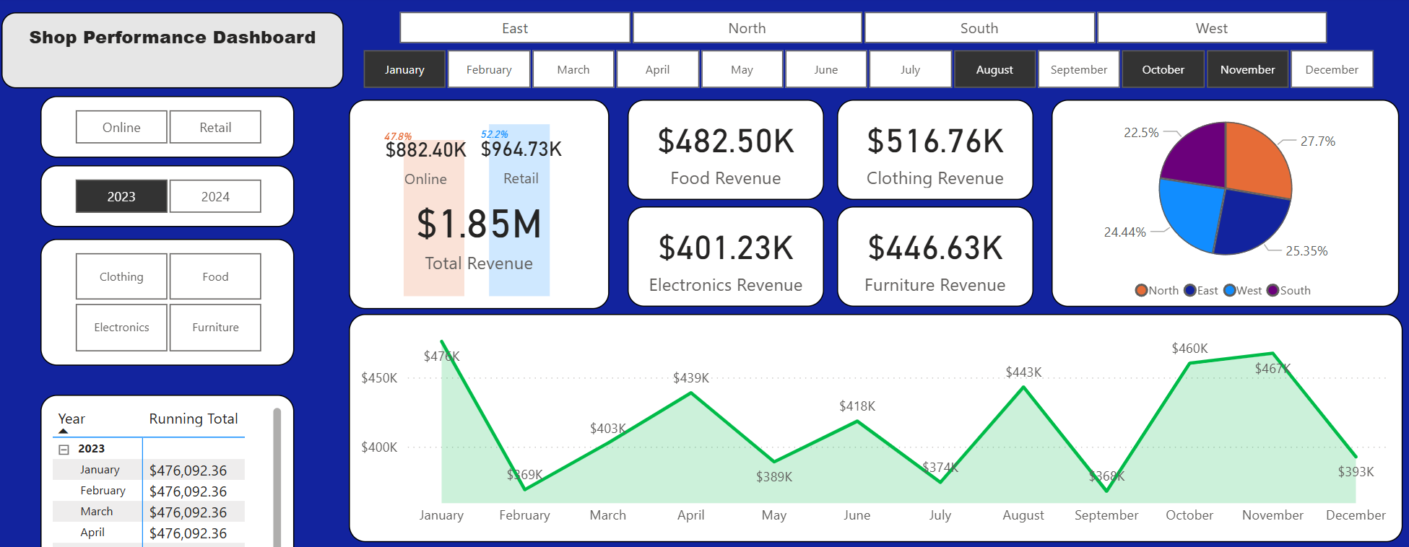
Top 4 Months
The Month of January showing strongest revenue return of ~476k.
Closely followed by November ($467k), October ($460k) and August ($443k)
Across these 4 months is a total revenue of ~$1.85M, 52.2% of which is through our Retail sales channel.
Product Category breakdown of the revenue:
Clothing: ~$519k
Food: ~$490k
Furniture: ~$446k
Electronics: ~$409k

Slide 4
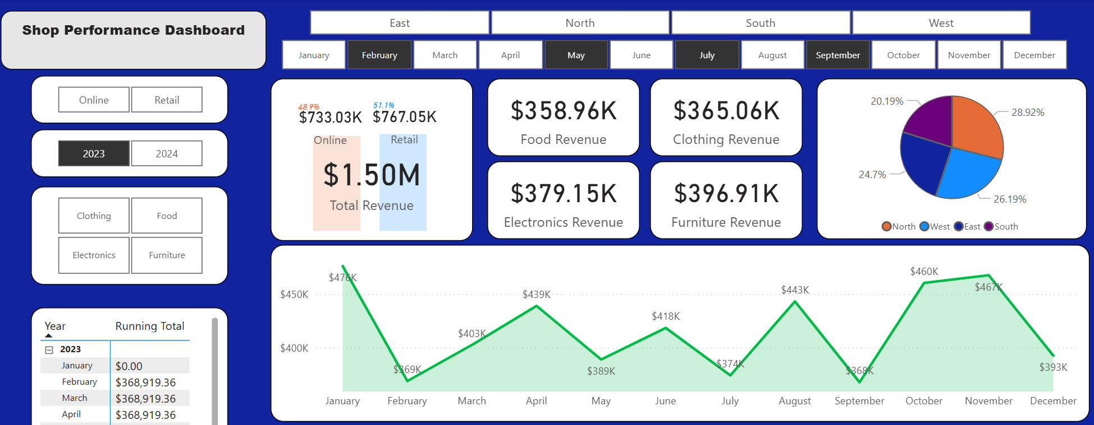
Bottom 4 Months
On the other end of the spectrum, the 4 months that has the least amount of revenue amassed ($1.50m), in descending order are:
May @ $389k
July @ $374k
February @ $369k
September @ $368k
Product Category breakdown of the revenue:
Furniture: ~$396k
Electronics: ~$379k
Clothing: ~$365k
Food: ~$358k

Slide 5
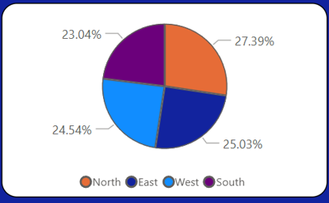
Looking at the 4 best and worst months of revenue, we can see that our most reliable product categories are:
Clothing
Furniture
With the bottom 2 performing stores being West and South.
These variables will be our improvement focus.

Slide 6
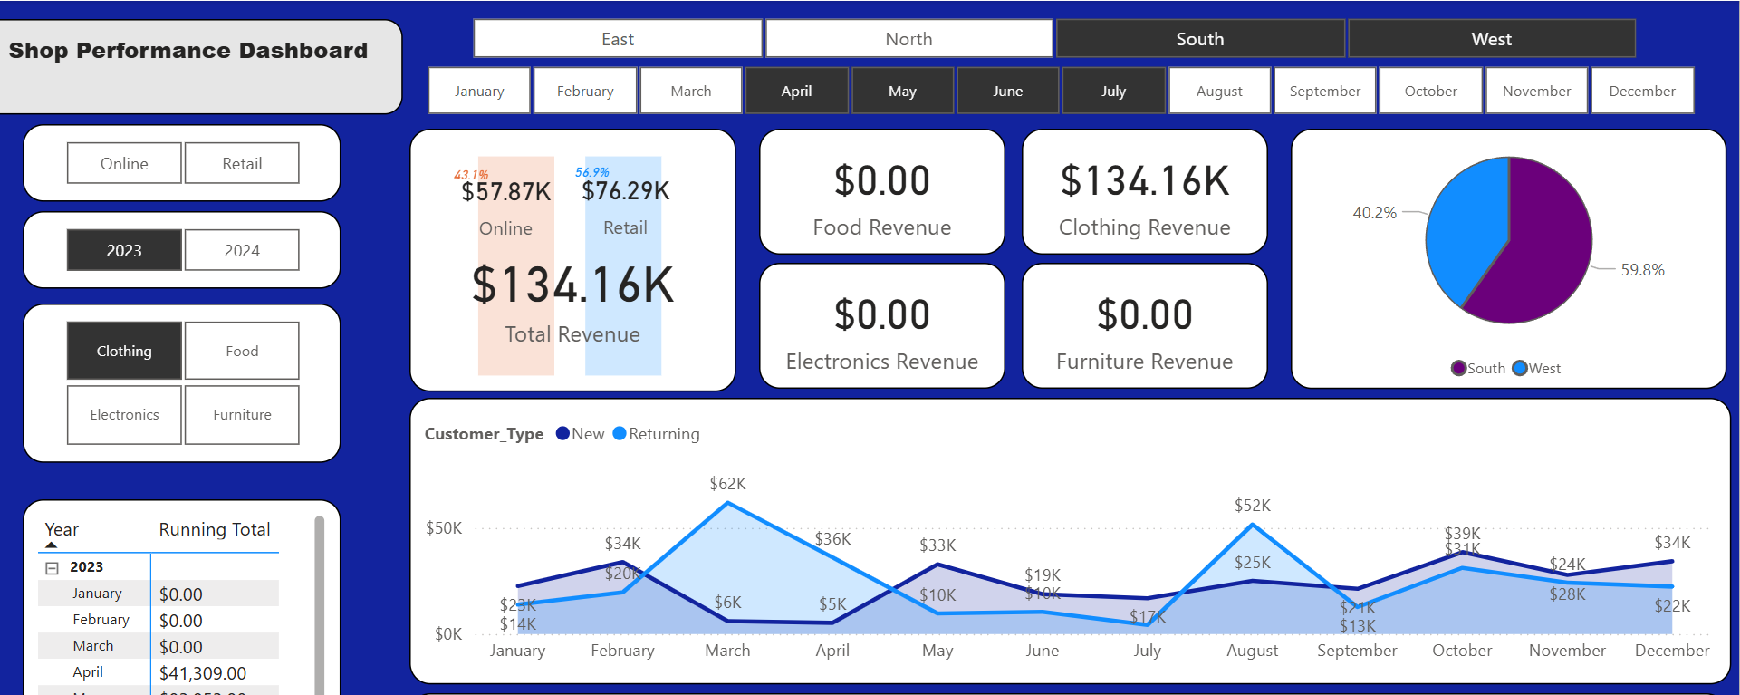
Clothing
As we can see, there's a lull period in revenue for the period April to July with a noticeable dip in returning customer purchases.
Suggestion: To address this lull for April - July period for our SOUTH and WEST stores' returning customers, we can explore the option of introducing a limited time, in-store only 'Loyalty' offer (To be assessed by Marketing team) for our Clothing products.
This should not only bolster the sales for our returning customers but will have an added effect of incentivizing new customers to join our Loyalty program.

Slide 7
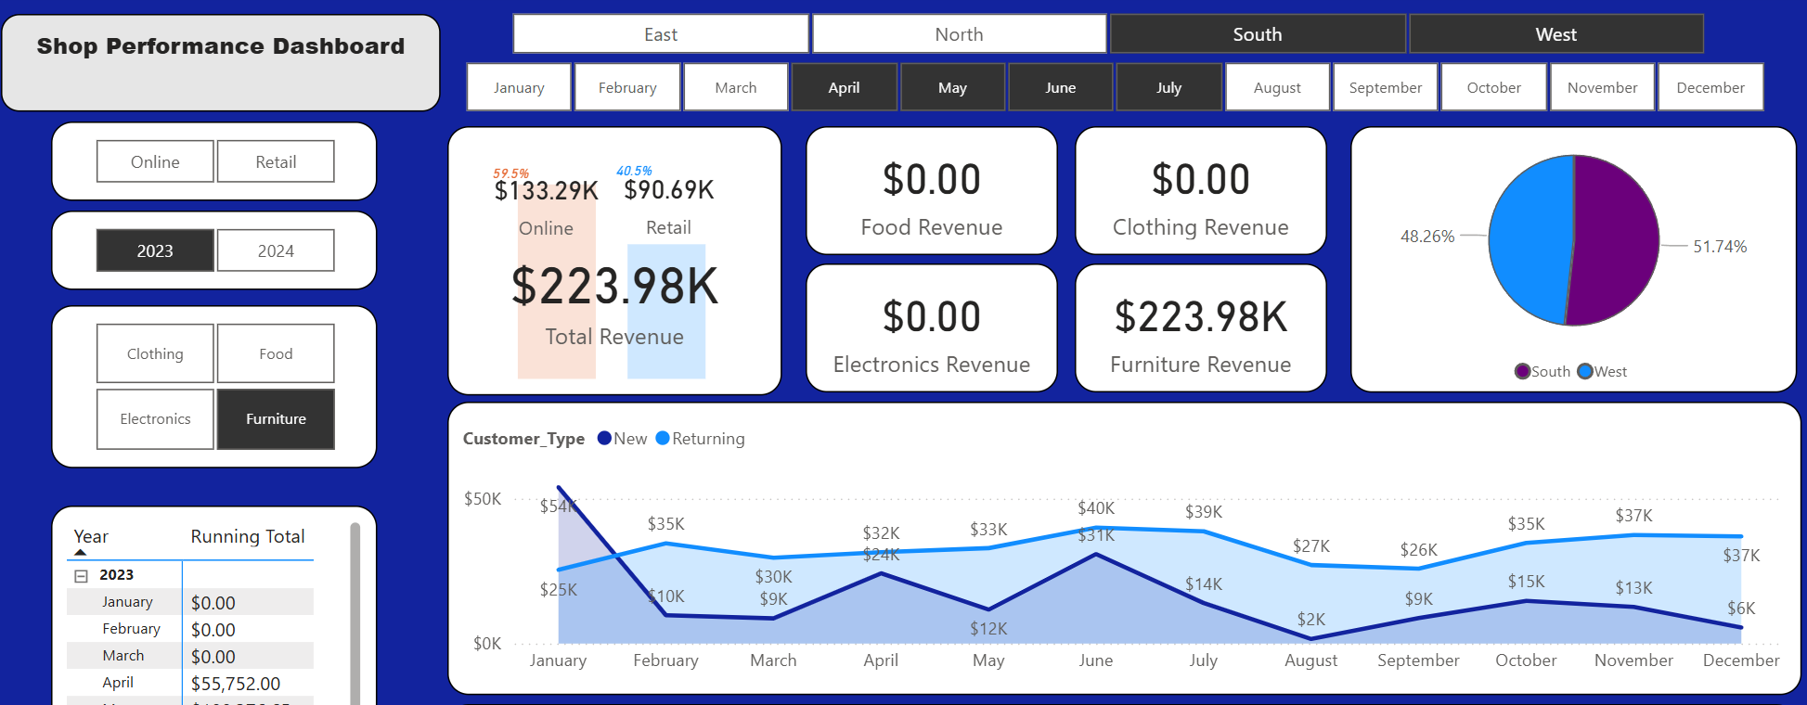
Furniture
While furniture purchases by returning customers is steady, there’s a noticeable dip in revenue from new customers for May and a downward slope starting from June through to August.
Suggestion: We can explore the option of running a limited time, signup offer for new customers for these quiet periods (May, June - August).
We can also pair this with a SOUTH & WEST location-specific, instore only promotions for certain pieces during this period.
This will not only increase incentive for new customers to sign up to our loyalty program but will also provide the chance for our in-store representatives to direct attention to our other pieces and/or up-sell the customers while at the same time increasing exposure to those locations.

